Slide 1
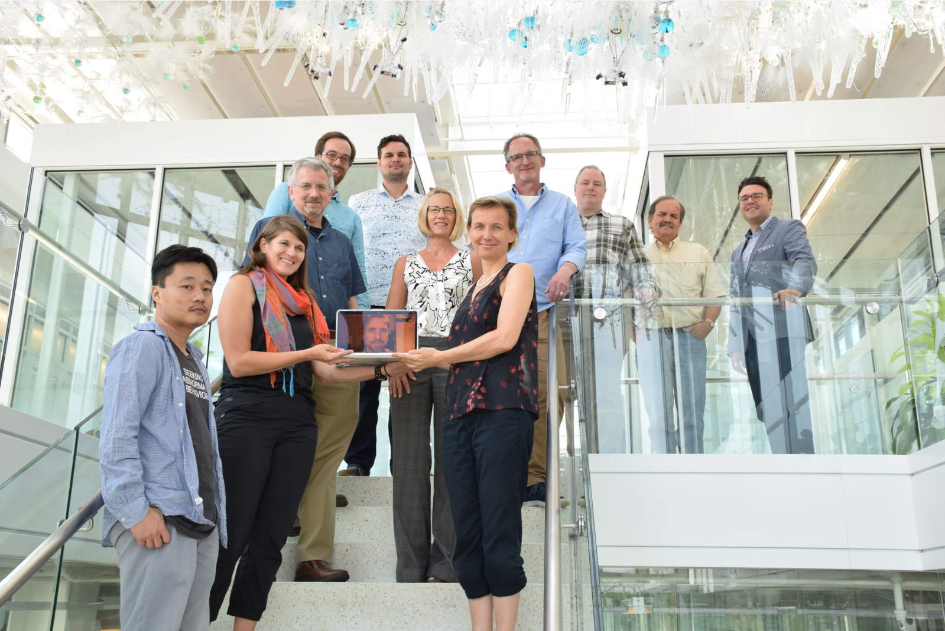
Katy Börner (PI), Victor H. Yngve Distinguished Professor of Intelligent Systems Engineering & Information Science
Luddy School of Informatics, Computing, and Engineering, Indiana University, Bloomington, IN, USA
This project seeks to transform data on millions of jobs and associated skills into powerful tools for data-driven decision support so workers and career coaches have increased awareness and a more proactive stance in recognizing impending job risks, transferring existing skills to future-proof jobs, and accessing reliable information on training opportunities.
TRACK B1: AI and Future Jobs:
Situational Awareness for Employment Resilience (SAFER)
B6656
Notes:
SAFER = Tech Innovation & Dream Team!

Slide 2


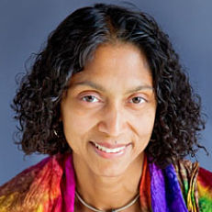




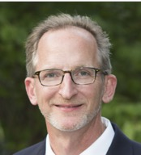
SAFER Team & Partners
Research & Development Team
Börner (PI), Liu (co-PI), Simon (co-PI), Gupta, Indiana University
Storksdieck (co-PI) and Heather Fischer, Oregon State University
André Skupin (co-PI) and Sean Ahearn, BigKnowledge LLC
Kemi Jona (Consultant)
Data Collaborators
Emsi & Burning Glass Technologies
Dissemination and Testing Collaborators
InStride & Skillful Indiana
Library and Museum Collaborators
Association of Science and Technology Centers & American Library Association
Notes:
TODO: Need pics for XL, Kosali
Add names below each

Slide 3
SAFER Team
AI/ML & Computational Modeling and Visualization
Labor Economics
Börner (PI), Liu (co-PI)
Indiana University
Simon (co-PI), Gupta
Indiana University
Cartography
Learning Sciences, Research & Evaluation
André Skupin (co-PI), Sean Ahearn
BigKnowledge LLC
Kemi Jona
Consultant
Storksdieck (co-PI), Heather Fischer Oregon State University
Notes:
TODO: Need pics for XL, Kosali
Add names below each

Slide 4
We knew that: AI, ML, and automation will impact tens of millions of US workers. Only 32 percent of workers believe their jobs will be replaced by automation.
Leaving 68% at risk of being unprepared.
Before COVID
https://futureofwork.wework.com/about
Notes:
What accounts for this 20 point gap? How do we close it?
How do we inform and mobilize millions of workers?

Slide 5
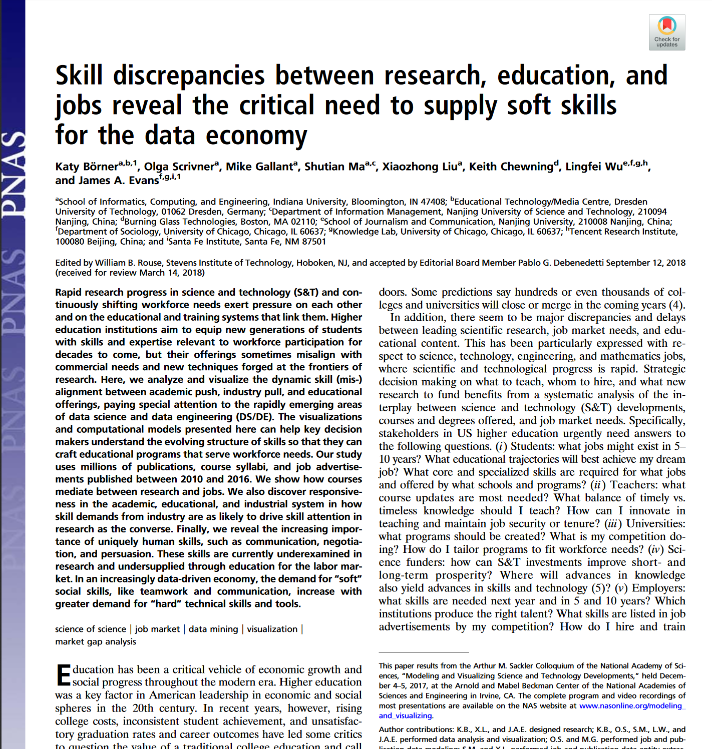


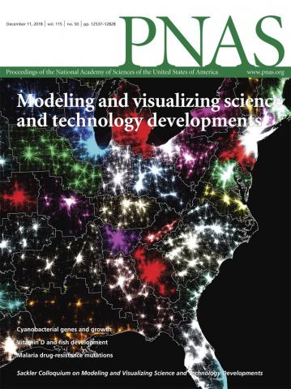
Before COVID
https://www.pnas.org/modeling
Notes:
Computational predictive models can be used to forecast the weather but also future S&T and job market developments.

Slide 6
During COVID
Virtually every sector of the labor market has been affected, with minorities and other economically marginalized populations disproportionately impacted.
Long-term AI/ML impacts may continue and accelerate, with some estimating that over 40% of jobs may not return.*
We are at a moment where awareness of “job risk” is now part of the national conversation like never before.
*https://www.nber.org/papers/w27137.pdf
Notes:
Economically marginalized populations are disproportionately affected.
African-Americans +2.5
Hispanics +4.7
In Indiana, about ½ a million people are out of jobs and actively looking for work (“unemployed”) in Indiana as of mid April.
16.7% of the workforce (which in Indiana is 3,237,228 people by link below) are unemployed—making us the 47th worst state for job losses.

Slide 7
But which jobs are least risky?
Notes:
Workers of all ages and almost all professions are affected

Slide 8
Our Phase II work will provide workers and career coaches increased awareness of impending job risks, support in mapping existing skills to more future-proof jobs, and reliable information on training opportunities.

Slide 9
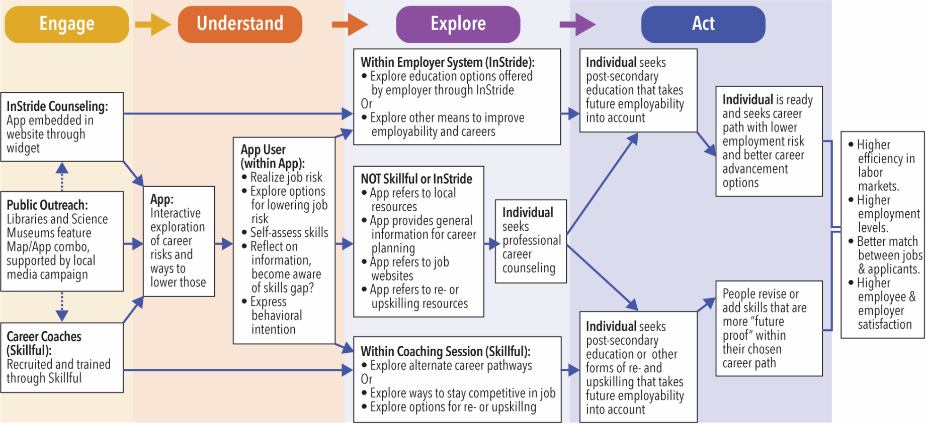
Key Insight from Phase I:
Notes:
Assumptions behind most solutions in the market today (including a number of other track B proposals)
Workers know they need a new job that is less risky and just need to go online and search
Or they know they need to reskill and can just go to an online resource like edX or Coursera, or a government site like Career One Stop and find relevant training
We too started with this mistaken assumption in Phase I

Slide 10
… but our Phase I research and the literature suggests there are three important phases that are UPSTREAM from where these other solutions focus.
Notes:
Individuals must be ready to engage in job searching or upskilling
Individuals & counselors must have sufficient knowledge of employment landscape in order to support exploration and action
Counselors must have tools and knowledge to scale up for dealing with hundreds of workers
Much exists much research (see Martin’s text in IVCR2 proposal) on
Risk Assessment
Risk Communication
Discount Rates and Behavior
Behavior Change
Key takeaway: Need to engage emotions to change behavior.
How can S&T best engage emotions in a serious and rigorous way?

Slide 11
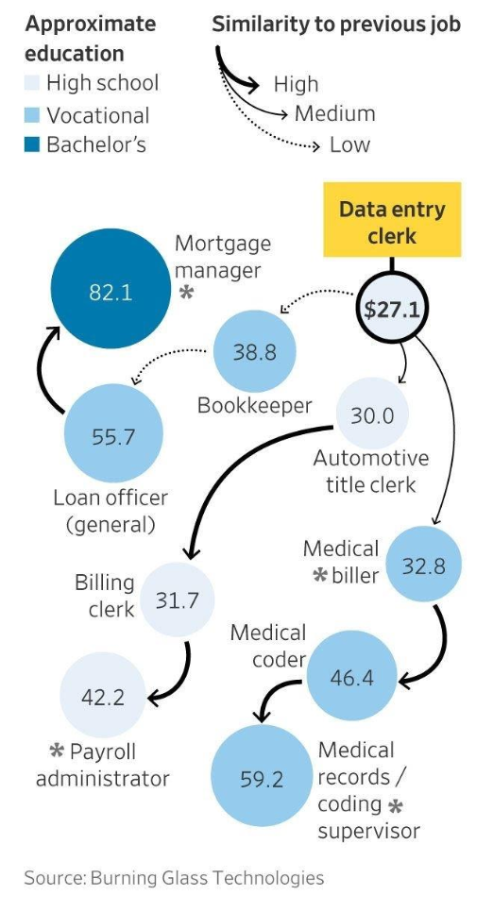
Notes:
In the real world, people – particularly low income or unemployed workers – need to find a more secure and better pay job that is as immediately accessible as possible. Most workers can not take months or years to reskill - they need the nearest neighbor job to support their families.
They need tools to help them explore which lower risk or better paying jobs are closest to their current skill set…. But even though there are data sets of real time labor market information, this data isn’t accessible or actionable to the American worker.

Slide 12
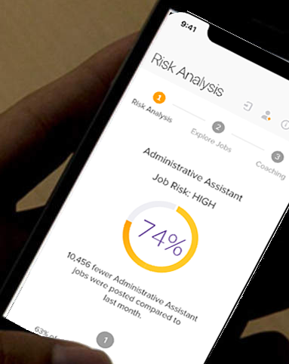
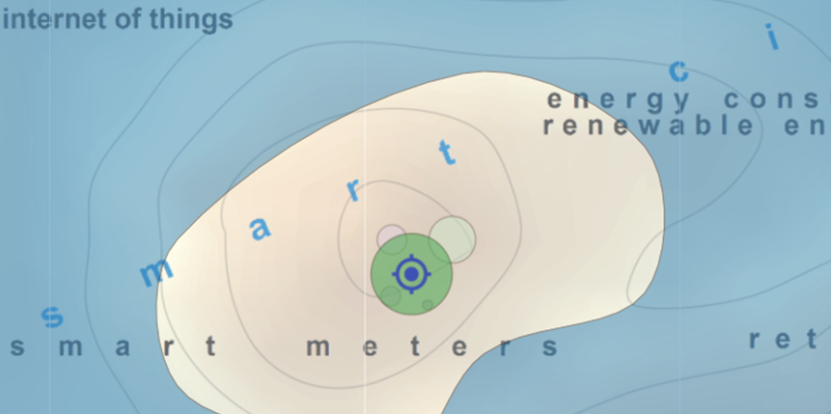
Individualize
Contextualize
SAFER
App
Third Party Sites
Partners, Public Venues, Devs
Employment Map
Widgets & APIs
Risk Score API
Employment API
Skill Risk Scoring
Graph Mining
Risk Prediction
Job Recommendation
Employment Concept Mapping
Natural Language Processing
Neural Network Training
Data Visualization
Data Infrastructure
API Ingest | Extract, Transform, Load | Pre-Processing
Data Sources
Commercial and Government Data
Notes:
Talk about BIG data – our 3 data partners
Emphasize USER FRIENDLY tools – apps and visualizations (maps)
There is A LOT of sophisticated research and development that is needed to make this a reality

Slide 13
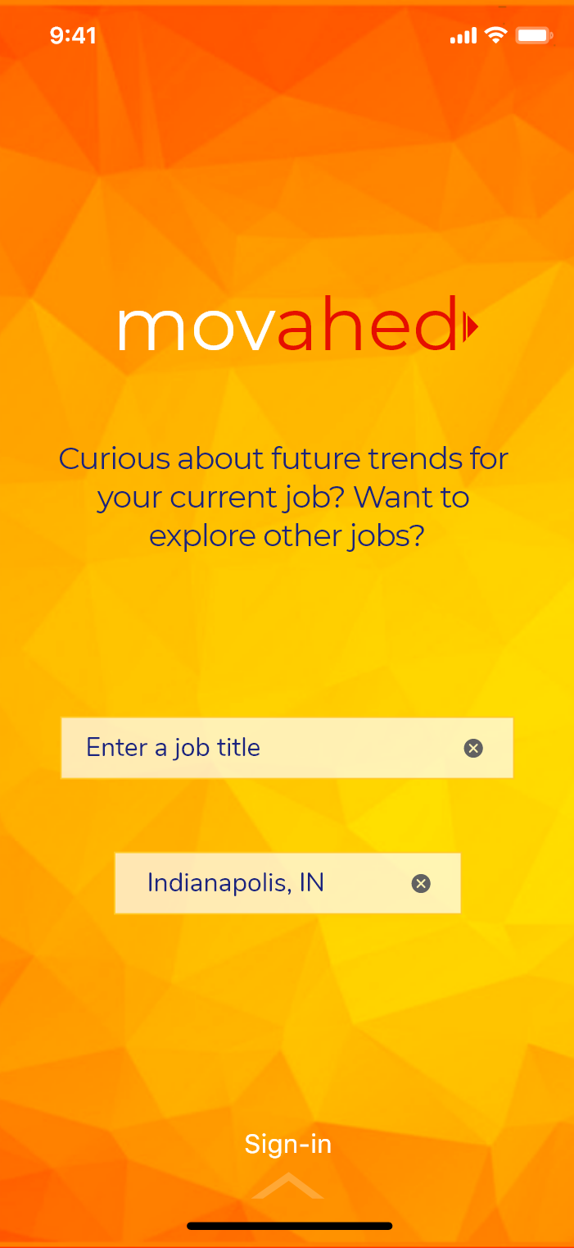
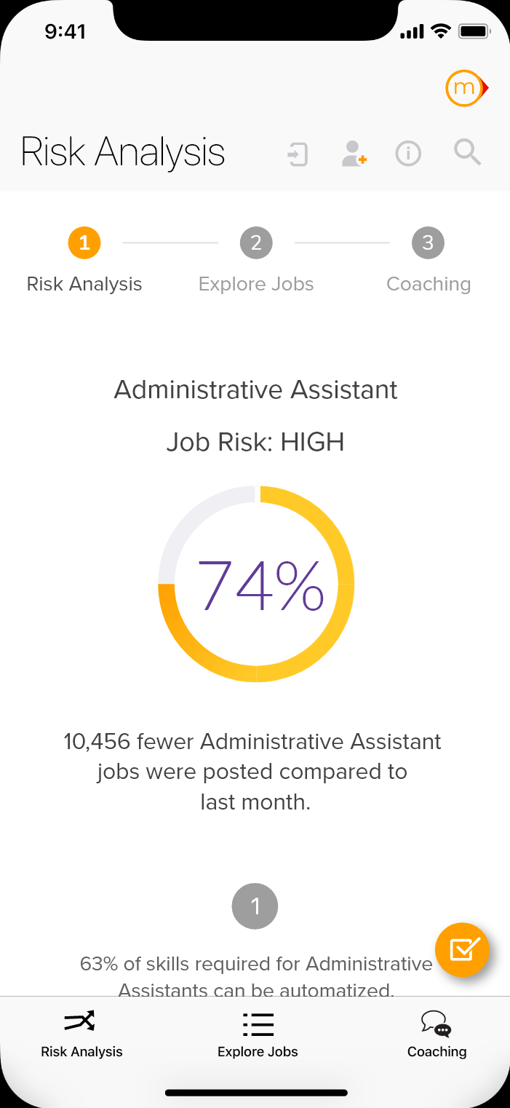
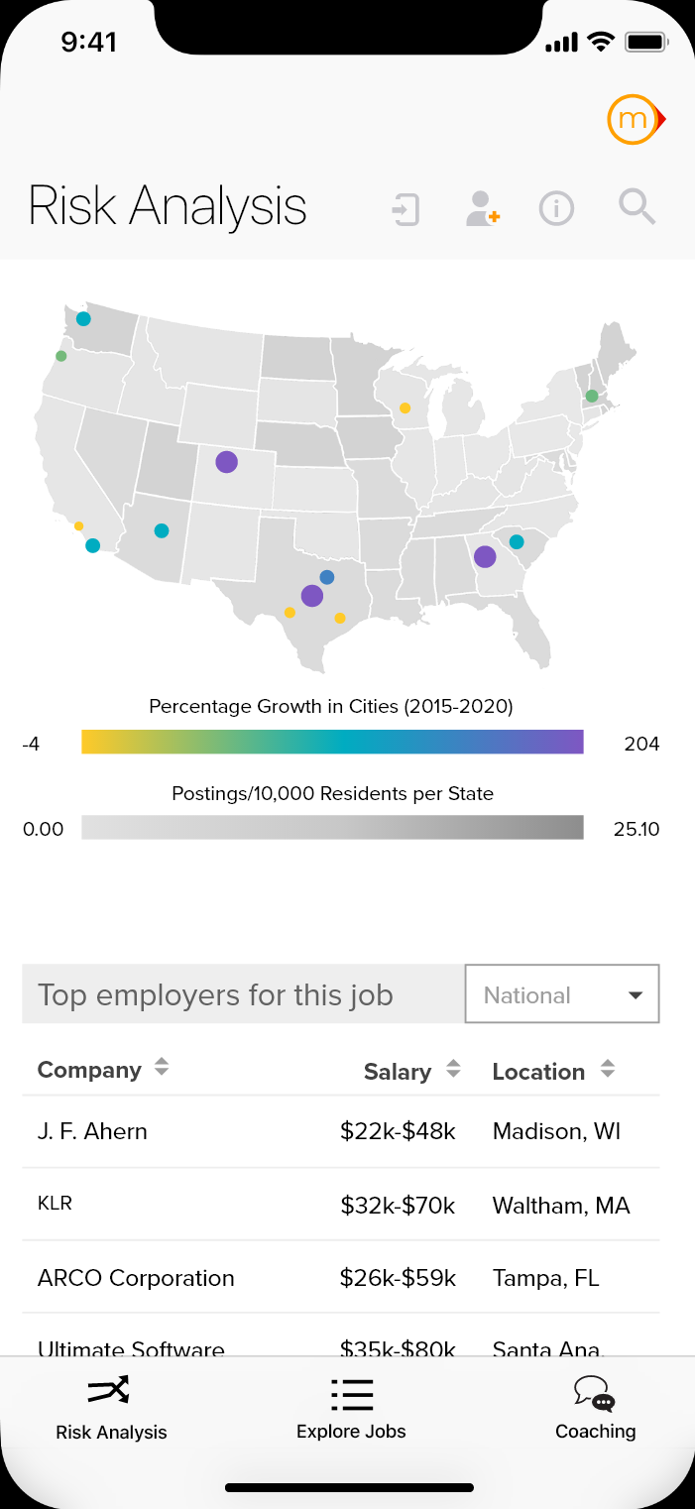

Individualize: Empower workers to understand risk
Notes:
image is too complex: can we use the second and third from left as examples…
We want to help people get back to work, but do so into jobs that are less risky in the near term and over the longer term too.
Our team will help mitigate the impact of the current crisis on the American worker and support a rapid, broad-based, and equitable economic recovery that helps to reduce economic inequalities and avoid a new macroeconomic equilibrium that disenfranchises large segments of the US workforce for years to come.
We will make it easy for anyone to explore risks and desirable future career trajectories.
Initially, help US workers quickly assess their job risk and make informed, labor market aligned reskilling choices.
Later (Y2): Deploy a GPS system that provides equitable access to high quality data and decision support to for a lifetime of learning and career advancement.
Demo Movahed App mockup at https://xd.adobe.com/view/30f6c240-9237-4372-504c-06c0e9aa03c5-46c7/

Slide 14
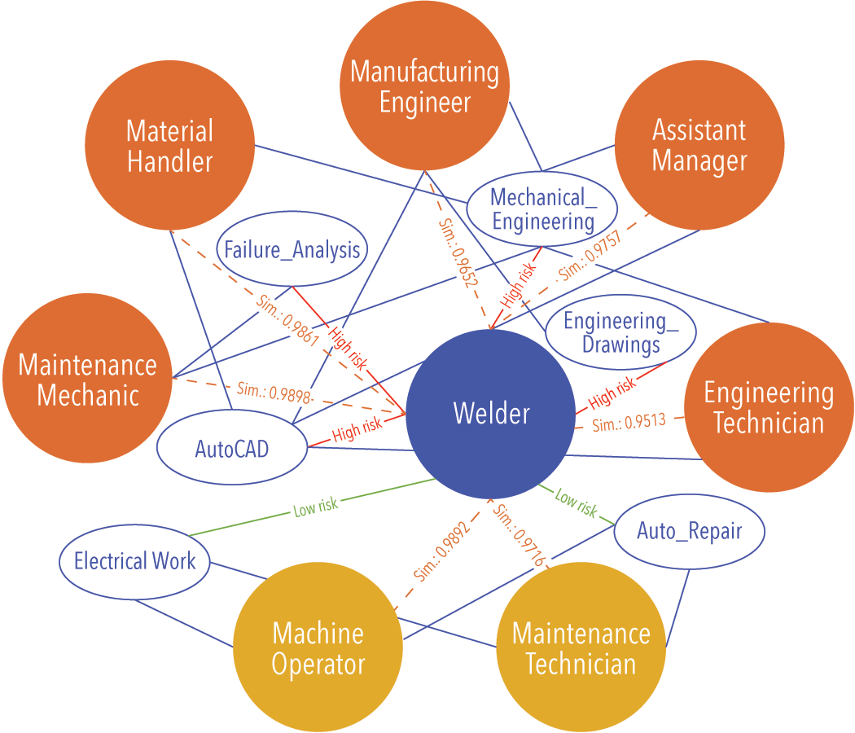
Compute Risks and Alternative Pathways
SAFER will use massive, high quality data and advanced algorithms
Data Provider | Data Type and #Records | Years Covered
BGT | 172M Jobs, 16k skills, resume data | 2007-2019
EMSI | 192M Jobs, 29k skills, career and resume data | Sep 2016-Jan 2020
NLx | 2.4M/100M Jobs, 300k Employers | 2017-2018
Longitudinal Employer Household Dynamics (LEHD) | Administrative, all US formal labor force aggregated data by county/6-digit industry | 1990-2019
Monthly Current Population Survey (CPS) | Survey (micro-data available), 60,000 households monthly | 1990-2020
Occupational and Employment Statistics (OES) | Survey-based, 800 occupations by state by year, job characteristics | 2012-2019
Occupational Information Network (O*Net) | Survey-based, characteristics of 1000 occupations, national level | 2003-2010
Job Openings and Labor Turnover Survey (JOLTS) | Survey-based, national, annual, at 6-digit industry | 2006-2019
Notes:
Skill risk mining by using regression and machine learning
Heterogeneous graph mining for job risk mining
Job recommendation via graph-based random walk plus risk analysis results

Slide 15
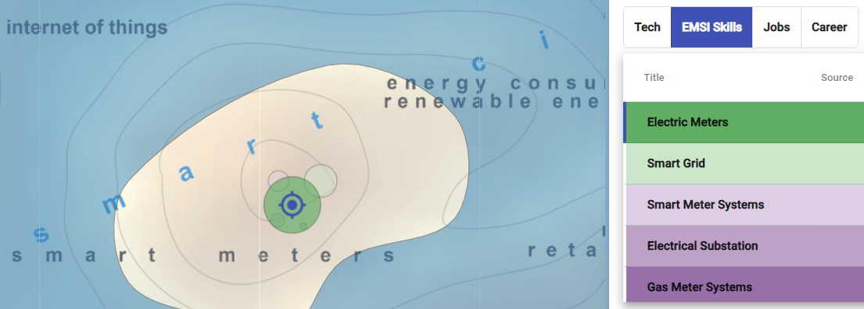
Contextualize: Scale Up Situational Awareness
Notes:
How we get there 3:
We need to SCALE UP the ability of workers, counselors and anyone engaged with the labor market to understand and operationalize what workers know and do and how that can be aligned with the evolving labor market.
Key example (top-left): 1. discover gap/hole in worker’s qualifications, then 2. find skills that would correspond to that gap and 3. find matching training options (not shown).
BUT: We FIRST need a detailed reference system (equivalent of latitude/longitude), base map (like a topographic map of the employment domain), and inference engine (like a GPS for employment)

Slide 16
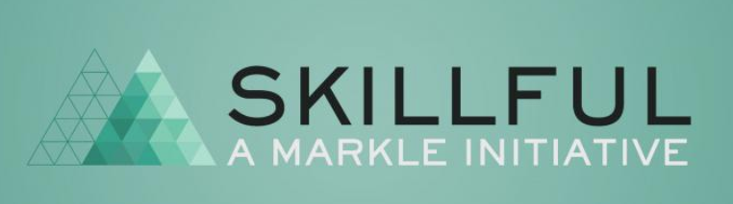

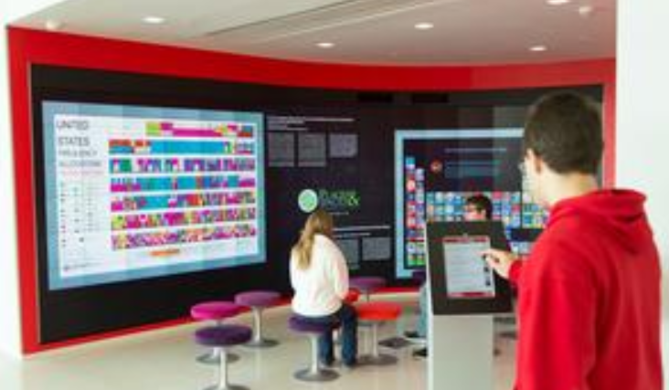
Phase II
Phase III
30/300 coaches
3,000 workers
29 States via Skillful State Network
50 coaches
5,000 workers
900,000 employees
30 employers
MCP Library
WonderLab
New York Hall of Science
57,000 Libraries
75 Million Museum Visitors Annually
Libraries & Museums
General Public Awareness: 34 Million Emsi annual website visitors
Notes:
Explain each partner in turn and how we work with them. (use animation build to explain impact and reach)
Skillful Indiana, a workforce development non-profit initiative in Indiana
InStride, a public-benefit corporation that connects more than 900,000 employees from 30 employers to higher education institutions,
the American Library Association and the Association of Science-Technology Centers

Slide 17
SAFER Roadmap
Phase I
Phase II
Phase III
From ADAPTIVE to SAFER
Needs Assessment
Data Federation
Initial Algorithm Design
Partnership Development
Initial System Design
App Mock-up and Testing
Year 1: Implement SAFER System
Expand Needs Assessment
Federate MASSIVE Datasets
Implement Optimized Algorithms
Design Employment Maps and Perform Outreach
Implement & Deploy SAFER APP
Collaborate with InStride and Skillful to Pilot-Test SAFER System
Year 2: Field-Test SAFER System and Prepare for Phase III
Deploy Broadly and Field-Test SAFER in Indiana and with InStride
Refine System and Expand to Other States
Launch National Campaign with Science Centers and Libraries
Design and Seek Support for Phase III
Commercial Service
Develop/serve industry-specific risk scores & employment maps as premium services.
License interface widgets and API services to interested parties, while keeping major SAFER services free of charge.
Notes:
we laid the groundwork in Phase 1 so we can hit the ground running in Phase 2. In Phase 2 we are finalizing the system in year 1, and testing and adjusting it, getting it ready for national launch in year 2, and in Phase 3 we will use an improved and stable system nationwide.

Slide 18
SAFER Reach & Impact in Phase II
5% of visitors to 57,000+ libraries and 500+ science museums and science centers
= Millions of visitors/patrons who can engage and understand
Skillful and InStride: hundreds of job coaches and career counselors trained
= more than 10,000 US workers who understand, explore and act
Emsi website: 34 Million annual unique visitors who can engage and understand
Impact
Notes:
We are changing minds, creating more resilient career pathways, and are supporting better matches in the labor market.

Slide 19






















Anchor Partners
Data Partners
B7061-RIPL
B7118-CE
B7037-NCSU
B7068-Eduworks
Track Success Partners
B6968-CO Mines
B6894-BHEF
B7026-NASWA
Data Privacy & Security Working Group
Advisors
Notes:
Data Privacy & Security Working Group (NSF Cross-Track Teams): Kyle Bradbury (A7137), Ryan McGranaghan (A7152), kc claffy (A7165), Lisa Kerr (A6950), Sean Gordon (A7908), Chuan Yue (B6968), Denis Nekipelov (B6956), Matt Gee (B7068), Lucila Ohno-Machado (A7136), Margaret Levenstein (A6844), James Ferri (A7017), Katy Borner (B6656), Luis Amaral (A7231), Krzysztof Janowicz (A6677) and Arthur Huang (B7833)

Slide 20

Thank you for keeping US !

Slide 21
